Slide 1
Computer Programming 1 Pracownia Programowania 1
Course Introduction

Slide 2
Course Instructor
My e-card
https://e-uczelnia.uek.krakow.pl/course/view.php?id=218

Slide 3
Course Content
Class Number | Class Topic
01 | Course Introduction
02-05 | Part 1: PROGRAMING BASICS
06-09 | Part 2: DATA STRUCTURES
10-12 | Part 3: OOP FOUNDATIONS
13-14 | Test Retake
15 | Final Class/Grades

Slide 4
Course Content: Part 1 - Programming Basics
02 - Types and Variables
03 - Control Structures
04 - Subroutines
05 - TEST 1

Slide 5
Course Content: Part 2 - Data Structures
06 - Arrays
07 - Files
08 - Dictionaries, Stacks and Queues
09 - TEST 2

Slide 6
Course Content: Part 3 - OOP Foundations
10 - Classes and Objects
11 - Inheritance
12 - TEST 3

Slide 7
Conditions for Completing the Course
You will get points for three tests
You can get extra points for completing additional (optional) tasks
If you are not prepared for the regular class, you may lose some points
---
You have to pass every test (3 tests)
If you fail three tests, you have to repeat the course in the next academic year
If you fail one or two tests, you may retake the tests during retake classes at the end of the course

Slide 8
Tests
Course item | Max. points | Min. pts for passing (50%)
Test 1 | 30 | 15
Test 2 | 30 | 15
Test 3 | 40 | 20
TOTAL | 100 | 50

Slide 9
Final Grade
The final grade is determined on the basis of the obtained number of points
Total Points | Final Grade
>= 90 | 5.0
>= 80 | 4.5
>= 70 | 4.0
>= 60 | 3.5
>= 50 | 3.0
< 50 | 2.0

Slide 10
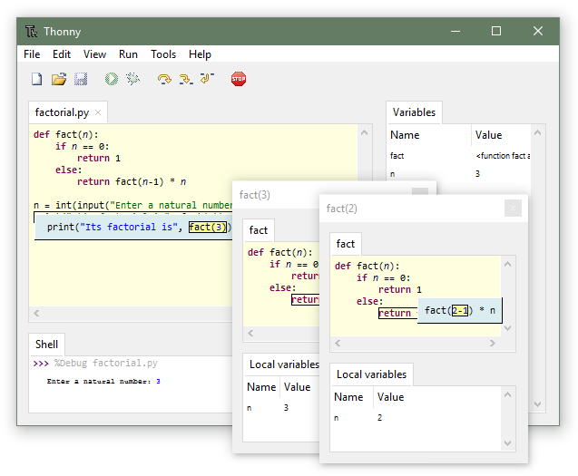
Tools
Thonny (Python IDE)
https://thonny.org
Python Programming Language
https://www.python.org/downloads
Other
Visual Studio Code, PyCharm, …

Slide 11
Python Teaching Aids
Python for Everybody (book)
https://www.py4e.com/book
Python Tutorial
https://docs.python.org/3/tutorial/index.html
MIT Introduction to Computer Science and Programming Using Python
https://www.youtube.com/playlist?list=PLRJdqdXieSHN0U9AdnmwD-9QcR9hmw04d
W3schools Python Tutorial
https://www.w3schools.com/python/default.asp
SoloLearn Python Course (Android)
https://play.google.com/store/apps/details?id=com.sololearn&hl=en

Slide 12
Storing program codes
Try to store all your program codes
Use GIT version control system
https://git-scm.com
Use GITHUB distant repositories
https://github.com

Slide 13
GIT Teaching Aids
Git & GitHub Crash Course For Beginners
https://www.youtube.com/watch?v=SWYqp7iY_Tc
GIT Cheat Sheet
http://rogerdudler.github.io/git-guide/index.html
GIT manual
https://git-scm.com/book/en/v2
GIT course (in Polish)
https://www.youtube.com/playlist?list=PLjHmWifVUNMKIGHmaGPVqSD-L6i1Zw-MH

Slide 14
Signing up for the course on Teams
Use the Code

Slide 15
Communication
Use course forum on Teams
Use Microsoft Teams chat
Take part in office hours (details on teacher’s e-card)
Send an email (details on teacher’s e-card)

Slide 16
After Introductory Class
Install Thonny Python IDE
Install Python
Check that the installed tools are working properly
e.g. calculate 3+2 in interactive mode
Install GIT control version system
Create an account on GITHUB
use your real name and surname
use your university email
Try to transfer some files from local computer to github repository

